Slide 1
Image Classification vs. Object Detection vs. Image Segmentation
Deep Learning

Slide 2
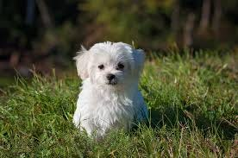
Image Classification vs. Object Detection vs. Image Segmentation
Image Classification

Slide 3
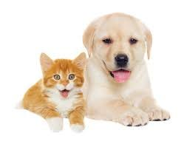
Image Classification vs. Object Detection vs. Image Segmentation

Slide 4
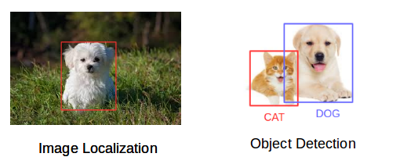
Image Classification vs. Object Detection vs. Image Segmentation

Slide 5
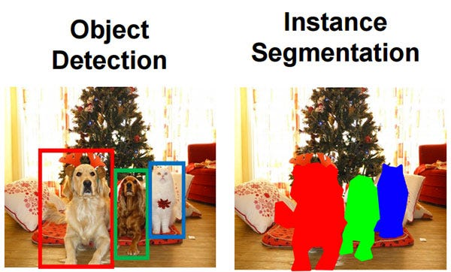
Image Classification vs. Object Detection vs. Image Segmentation

Slide 6
Image Classification vs. Object Detection vs. Image Segmentation
Image Classification helps us to classify what is contained in an image.
Image Localization will specify the location of single object in an image whereas Object Detection specifies the location of multiple objects in the image.
Finally, Image Segmentation will create a pixel wise mask of each object in the images.
We will be able to identify the shapes of different objects in the image using Image Segmentation.

Slide 7
Popular datasets for computer vision
Deep Learning

Slide 8
What is Computer Vision?
Computer vision is a field of study within artificial intelligence (AI) that focuses on enabling computers to Intercept and extract information from images and videos, in a manner similar to human vision.
It involves developing algorithms and techniques to extract meaningful information from visual inputs and make sense of the visual world.
Examples of CV:
Facial Recognition
Self Driving cars
Robotic Automation
Medical Anomaly Detection

Slide 9
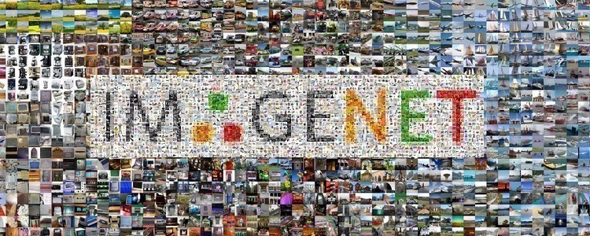
Datasets for CV
Here are 10 significant datasets that encompass a variety of computer vision tasks such as object detection, image classification, segmentation, and beyond.
ImageNet: A free, open database with over 14 million annotated images across 20,000 categories

Slide 10
Datasets for CV
CIFAR-10 & CIFAR-100:
CIFAR-10 is a popular dataset for object recognition, often used as a benchmark for computer vision algorithms, while CIFAR-100 is a subset of an 80 million image collection designed to help analyze real-world imagery.
CIFAR-10 contains 60,000 color images of 32x32 pixels each, spread across 10 categories, with each category containing 6,000 images. The dataset is divided into 50,000 training images and 10,000 testing images, covering a variety of subjects such as animals and vehicles.
In contrast, CIFAR-100 builds upon this by offering 100 categories, each with 600 images, totaling the same 60,000 images but with a more granular categorization.
It assigns 500 images for training and 100 for testing per category. Additionally, CIFAR-100 classifies its categories into 20 supercategories, with each image labeled with both a “fine” label for its specific category and a “coarse” label that indicates its supercategory.

Slide 11
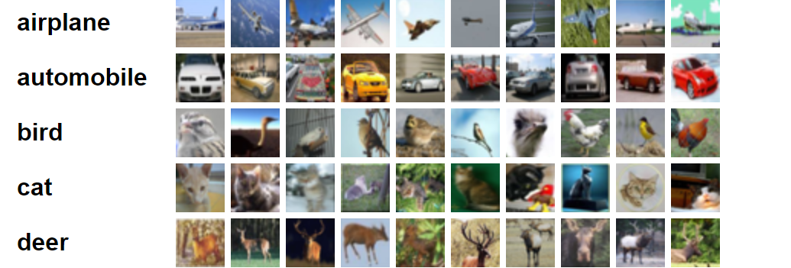
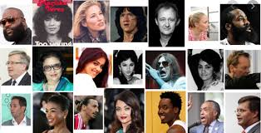
Datasets for CV
CIFAR-10 & CIFAR-100

Slide 12
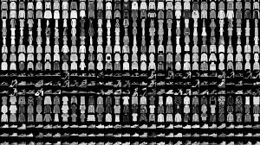
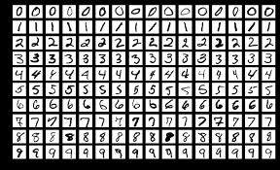
Datasets for CV
MNIST: A large database of 70,000 grayscale images of handwritten digits, with 60,000 for training and 10,000 for testing

